Slide 1
Machine Learning for Cloud Security
Challenges and Opportunities
Andrew Wicker

Slide 2
Cloud Security
Security is a top concern when migrating to the cloud
Attacks can cause irreparable damage
Different industries with targeted attacks
Types of Attacks:
  Data Breaches
  Leaked Credentials
  Malicious Insiders
  API Vulnerabilities
  Advanced Persistent Threats
  …

Slide 3
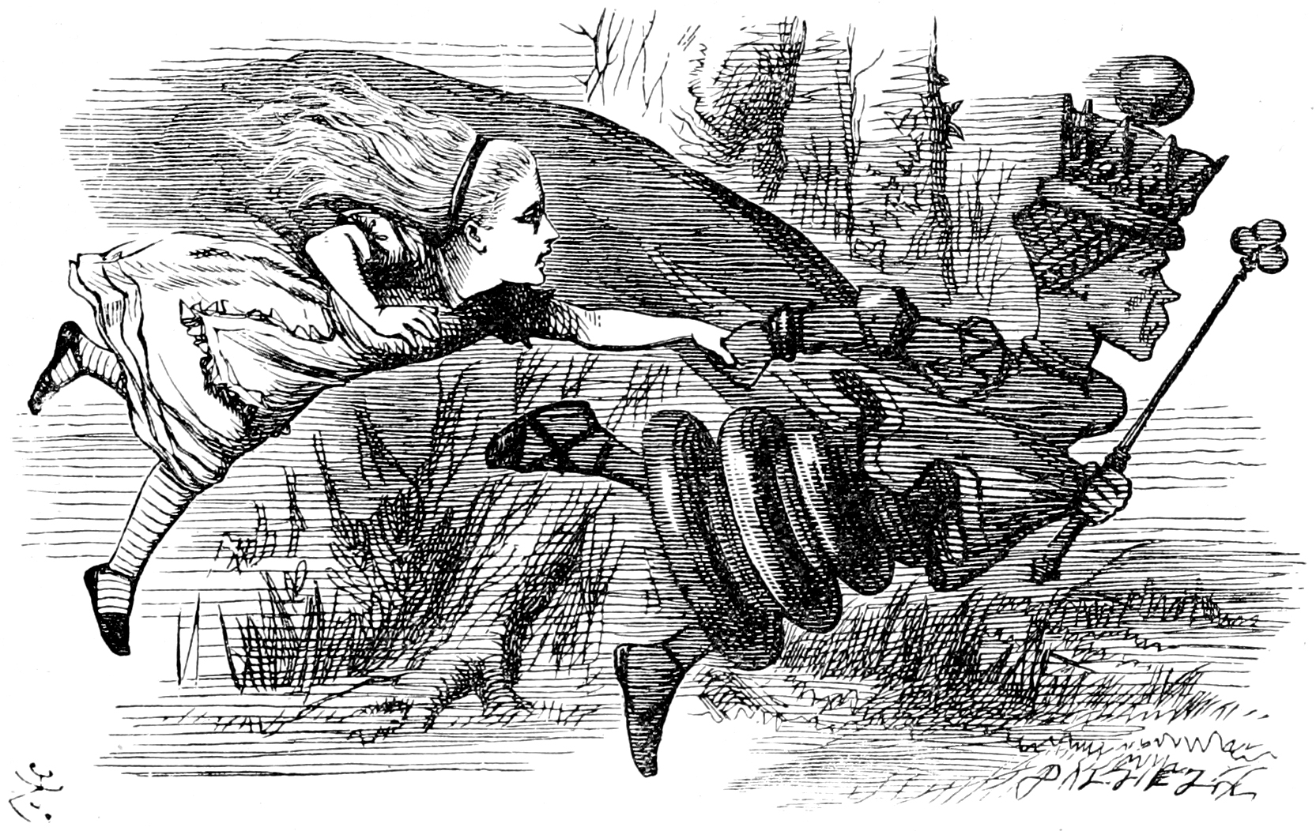
Red Queen’s Race
Detecting attacks is nontrivial
Tremendous effort to maintain current state of security
  Even more to detect new attacks
Blue Team
Red Team

Slide 4
Assume Breach
No longer assume we are immune!
We can not prevent human error
  Phishing is still incredibly effective

Slide 5
What can we do to make progress?

Slide 6
Challenge 1: Outliers to Security Events

Slide 7
Outliers to Security Events
Finding statistical outliers is easy
Finding anomalies requires a bit more domain knowledge
Making the leap to security event is challenging

Slide 8
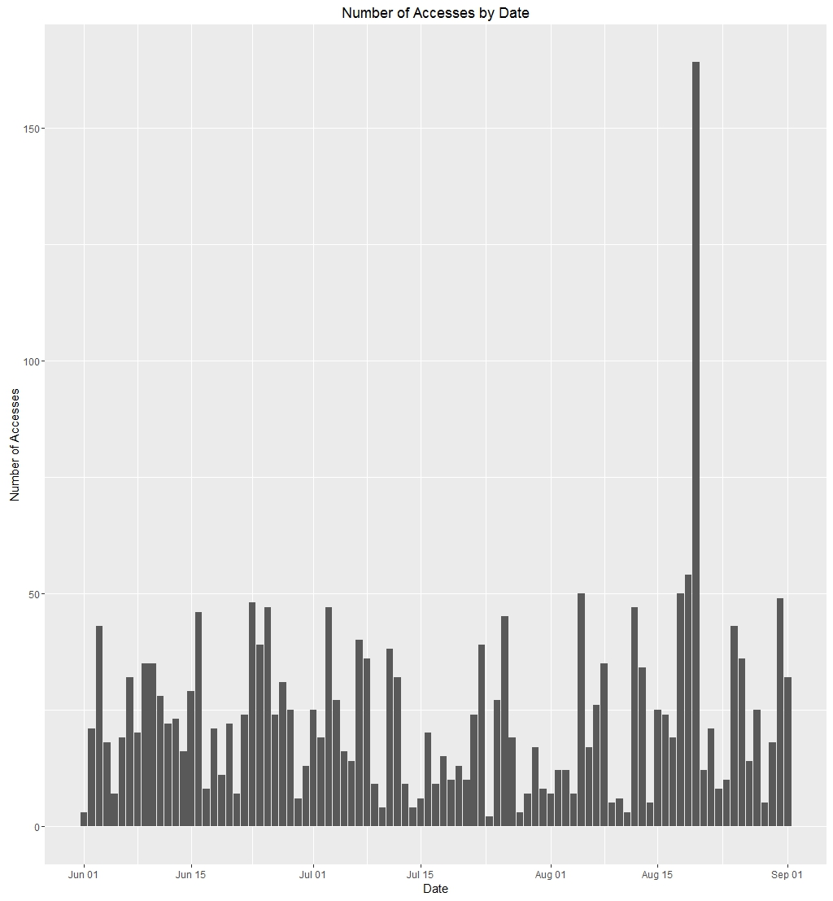
Uninteresting Behavioral Anomalies
Simple changes in behavioral patterns are insufficient
  Typically lead to high false positive rate
File access activity:
  User accesses one team’s files exclusively
  Suddenly accessing team files from different division within company
  Risky? Compromise?

Slide 9
Domain Expertise
Use domain experts to make the leap
“Tribal knowledge”
  Credential scanning patterns
  Storage compromise patterns
  Spam activity patterns
  Fraudulent account patterns

Slide 10
Threat Intelligence
Use threat intelligence data to improve signals
Benefits
  Indicators of Attack
  Indicators of Compromise
  Industries targeted
  IP reputation

Slide 11
Embrace Rules
Rules help filter noise from interesting security events
Sources:
  Domain experts
  TI feeds
Easy to understand
Difficult to maintain!
  Be careful relying too much on rules

Slide 12
Incorporating Rules
Top-level:
Bottom-level:
Action | OS | IP | App | IsHighRisk
AccessFile | Windows 10 | 102.13.19.54 | Excel | No
ModifyFile | Windows 8.1 | 23.12.16.65 | Browser | No
AddGroup | OS X | 74.23.76.12 | Browser | No
UploadFile | Windows 10 | 91.25.46.5 | SyncClient | No
AddAdmin | Windows 10 | 104.43.23.7 | Browser | Yes
If Action is in RiskyActions,
then Flag as HighRisk.

Slide 13
Security Events
More Useful
Security Domain Knowledge
Usefulness of Alerts
Less Useful
Anomalies
Outliers
Basic
Advanced
Sophistication of Signals

Slide 14
Challenge 2: Everything is in Flux

Slide 15
Evolving Landscape
Frequent/irregular deployments
New services coming online
Usage spikes

Slide 16
Evolving Attacks
Constantly changing environments leads to constantly changing attacks
  New services
  New features for existing services
Few known instances of attacks
  Lack of labelled data

Slide 17
ML Implications
Performance fluctuations of training/testing
  Important for RT/NRT detections
Concept Drift
  Data distributions affected by service changes
Monitors
  Understand the “health” of security signals

Slide 18
Make New Detections, But Keep the Old!
Don’t throw out your old detections
  Old attacks can be reused, esp. if attackers know monitoring is weak
Signals are never “finished”
  Must update to keep up with the evolving attacks

Slide 19
Challenge 3: Model Validation

Slide 20
Model Validation
Recap:
  Lack of labeled data
  Few known compromises, if any
  Changing infrastructure
  Service usage fluctuations
So, how do we validate our models?

Slide 21
What’s Your Precision and Recall?
As always, metric selection is critical
  Precision-Recall curve vs ROC curve
How do we define “false positive”?
  Augment data

Slide 22
Attack Automation
Domain experts provide:
  Known patterns
  Insights into what potential attacks might look like
Inject automated attack data
  Evaluate metrics against this injected data

Slide 23
Attack Automation - Caveat
Do not naïvely optimize for automated attacks
Precision vs Recall
  Many events generated by automated attacker may be benign
Be careful if labeling all automated attack events as positive label
  Lean toward precision instead of recall

Slide 24
Feedback Loop
Human analysts provide feedback that we can use to improve our models

Slide 25
Challenge 4: Understanding Detections

Slide 26
Understanding Detections
Surfacing a security event to an end-user can be useless if there is no explanation
Explainability of results should be considered at earliest possible stage of development
  Best detection signal with no explanation might be dismissed/overlooked

Slide 27
Results without Explanation
UserId | Time | EventId | Feature1 | Feature2 | Feature3 | Feature4 | … | Score
1a4b43 | 2016-09-01 02:01 | a321 | 0.3 | 0.12 | 3.9 | 20 | … | 0.2
73d87a | 2016-09-01 03:15 | 3b32 | 0.4 | 0.8 | 0 | 11 | … | 0.09
9ca231 | 2016-09-01 05:10 | 8de2 | 0.8 | 0.34 | 9.2 | 7 | … | 0.9
5e9123 | 2016-09-01 05:32 | 91de | 2.5 | 0.85 | 7.6 | 2.1 | … | 0.7
1e6a7b | 2016-09-01 09:12 | 2b4a | 3.1 | 0.83 | 3.6 | 6.2 | … | 0.1
33d693 | 2016-09-01 14:43 | 3b89 | 4.1 | 0.63 | 4.7 | 5.1 | … | 0.019
7152f3 | 2016-09-01 19:11 | 672f | 2.7 | 0.46 | 3.9 | 1.4 | … | 0.03
Good luck!

Slide 28
Helpful Explanations
Textual description
  “High speed of travel to an unlikely location”
Supplemental data
  Rank ordered list of suspicious processes
Variable(s)
  Provide one or more variables that impacted score the most
  Avoid providing too many variables

Slide 29
Actionable Detections
Detections must results in downstream action
Good explanation without being actionable is of little value
Examples
  Policy decisions
  Reset user password

Slide 30
Challenge 5: Burden of Triage

Slide 31
Burden of Triage
Someone must triage alerts
More signals => More triaging
Many cloud services
  And each must be protected against abuse/compromise

Slide 32
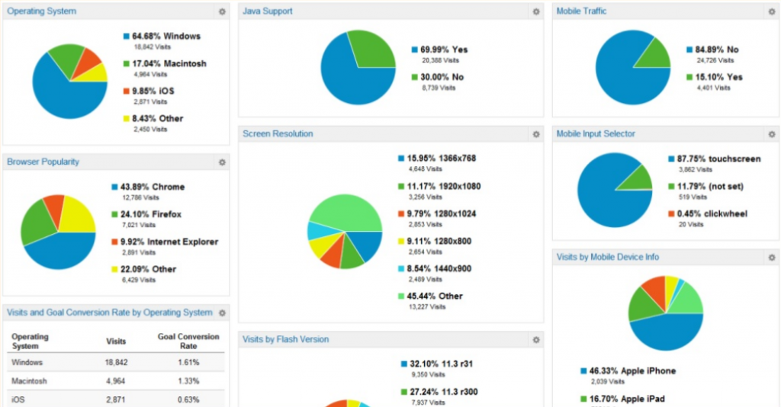
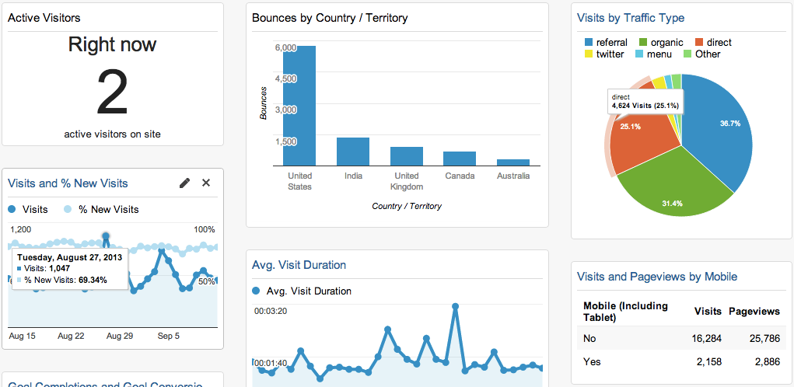
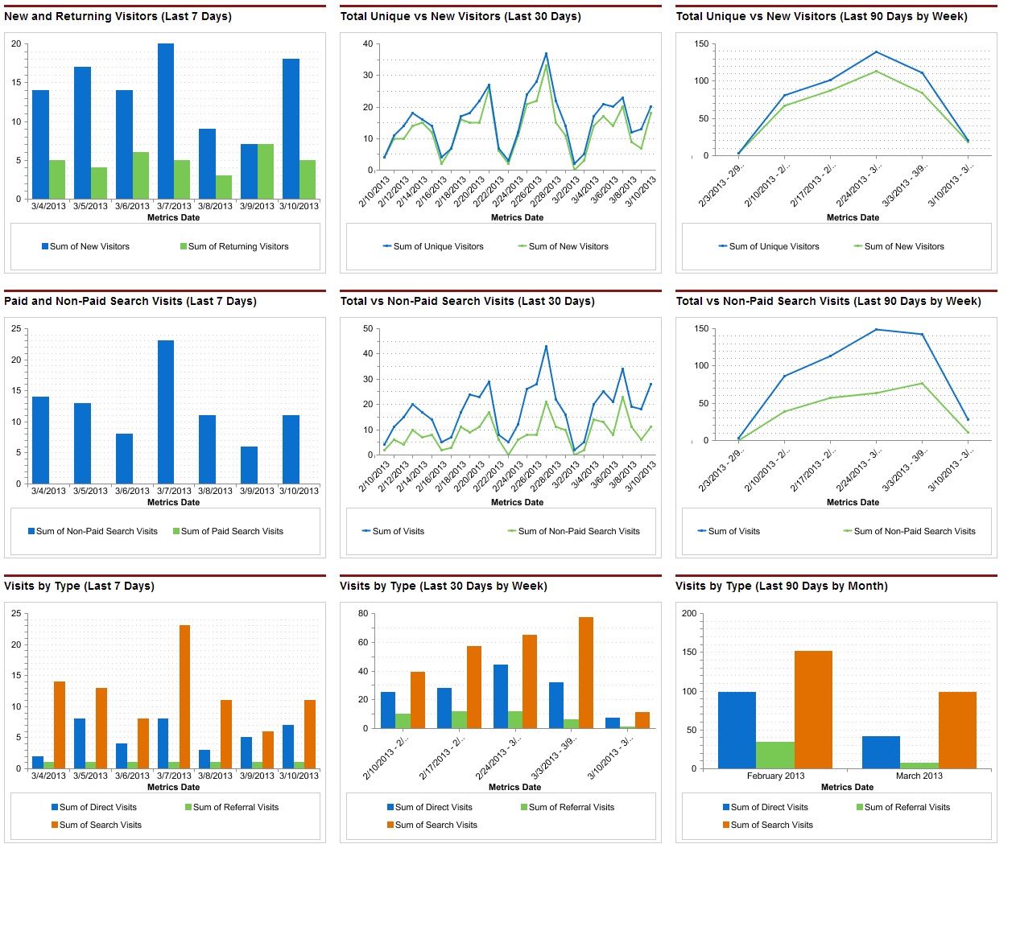
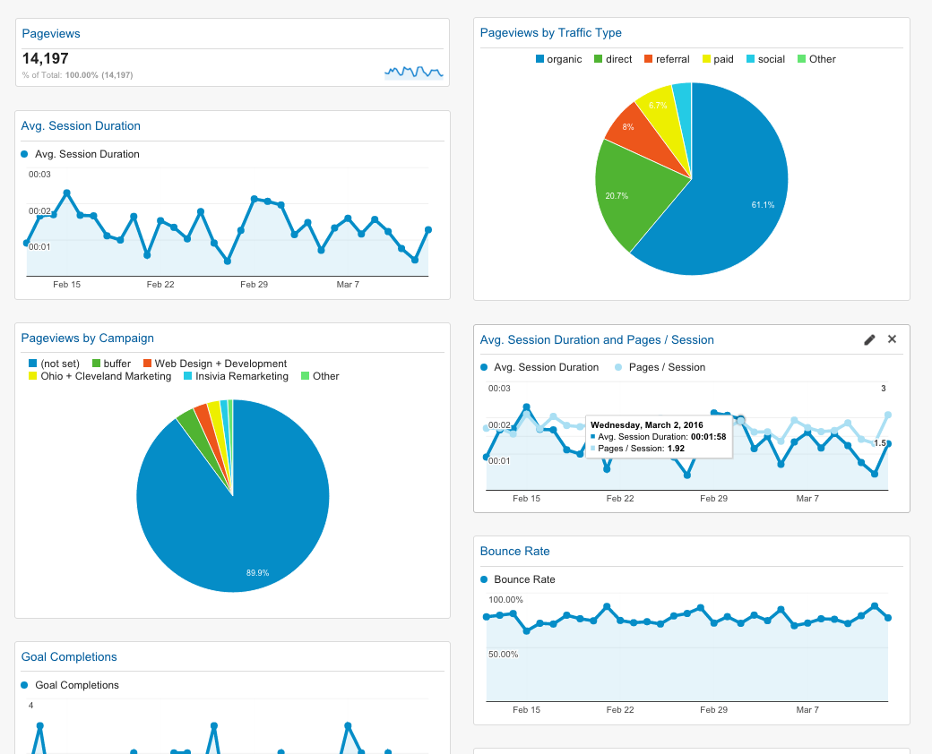
Dashboards!
Flood of uncorrelated detections
Lack of contextual information

Slide 33
Consolidate Signals

Slide 34
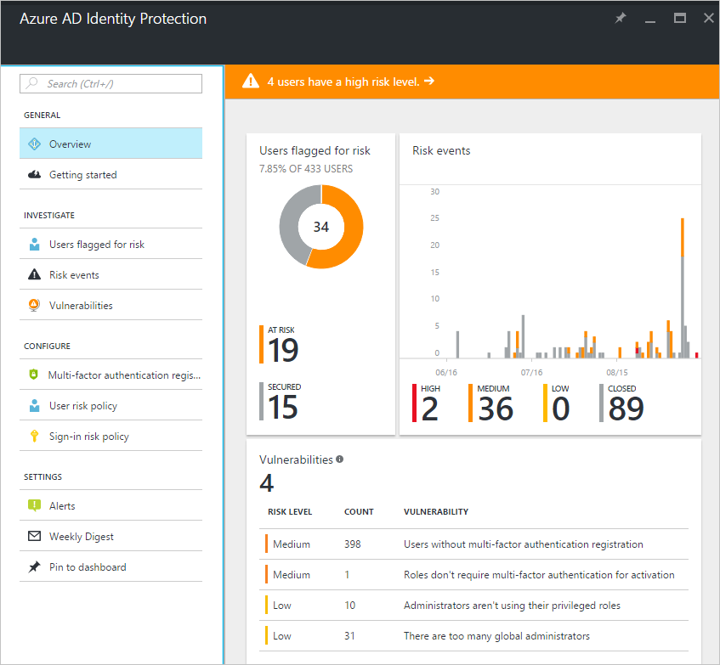
Integrated Risk
Reduce burden of triage via integrated risk score
  Combine relevant signals into a single risk score for account
Allows admin to set policies on risk score instead of triaging each signal

Slide 35
Summary
Outliers to Security Events
Everything is in Flux
Model Validation
Understanding Detections
Burden of Triage

