Slide 1
Cloud Security & Mitigating Vulnerabilities IAPP Knowledge Net October 4, 2016
Tony UcedaVelez, CISM, CISA, GSEC, CRISC Richard N. Sheinis, CIPP-US
Versprite Hall Booth Smith, PC
10 Glenlake Parkway 13950 Ballantyne Corporate Place
Suite 130 Suite 175
Atlanta, Georgia 30328 Charlotte, NC 28277
tonyuv@versprite.com rsheinis@hallboothsmith.com
(678) 278-8312 (office) (980) 859-0380 (office)
(404) 345-0749 (mobile)

Slide 2
Cloud Insecurity & Privacy Abuse
The Dawn of the Information Matrix

Slide 3
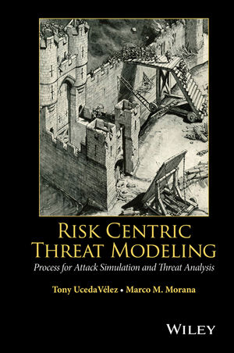
Speaker Bio
CEO, VerSprite – Global Security Consulting Firm (www.versprite.com)
Chapter Leader – OWASP Atlanta
Author, “Risk Centric Threat Modeling – Process for Attack Simulation & Threat Analysis”, Wiley June 2015
Former Sr. Security Director, Fortune 50 | Symantec | Dell-Secureworks
~20 years of global Information Security for various MNCs

Slide 4
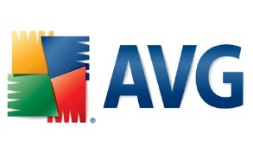
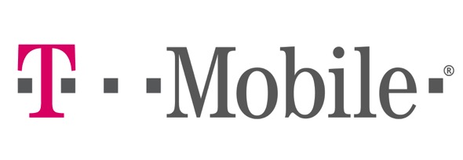
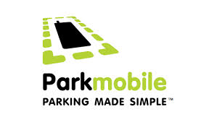
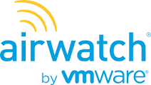
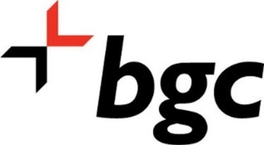
About VerSprite
Founded in 2007, Self Funded
Employees across 4 Countries | Serving the needs of nearly 10 countries world wide
Blackhat meets Suit meets Risk
Services in AppSec, GRC, Incident Response, and Security Operations.
Vendor Risk, Business Impact Analysis, Security Architecture, Enterprise Security Risk Analysis, Threat Models, Penetration Testing (Mobile, Web, Cloud)
FedRamp, FISMA, PCI-DSS, HIPAA, ISO 27001, EI3PA, NERC CIP, CSA, FCRA, EU Data Privacy
True spirited security

Slide 5
Flying Beyond the Cloud
Understanding Beyond Today’s IaaS | PaaS | SaaS | CaaS

Slide 6
Revisiting Key Drivers to Cloud
Cloud to matrix formation
Dynamic OnPrem environments too costly to manage in long run
$avings across licensing, network/sys administration,
Dynamic networks || systems || apps need to respond to growing, diversified threats

Slide 7
Atmospheric Shift to Agile
Cloud to matrix formation
Companies becoming more Agile
Agile development requires more agile environments
Other key drivers for flying to the Cloud
Business continuity and network resiliency
Risk transference opportunities (e.g.. – SLAs, security, compliance, etc..)
DevOps a new frontier for Cloud Management
Farming agile services via codified configs
Spinning up new services w/ control panels
Virtualization at all levels

Slide 8
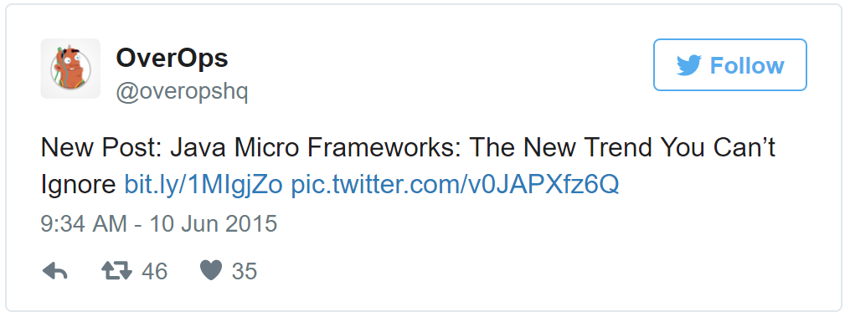
Frameworks Trending in the Cloud
Frameworks obfuscate security & privacy
Macro Frameworks
Meant for experienced developers
Has many built in components to facilitate authentication, encryption, & security
Micro-Frameworks
Gaining Lightweight, quick to get started
Meant for websites and smaller applications
JavaScript Frameworks
Provides crisp UI to interface with web frameworks

Slide 9
Weather Conditions in Cloud Operations
Process immaturity, security obfuscation, & the rush to B2B/ B2C service dominance

Slide 10
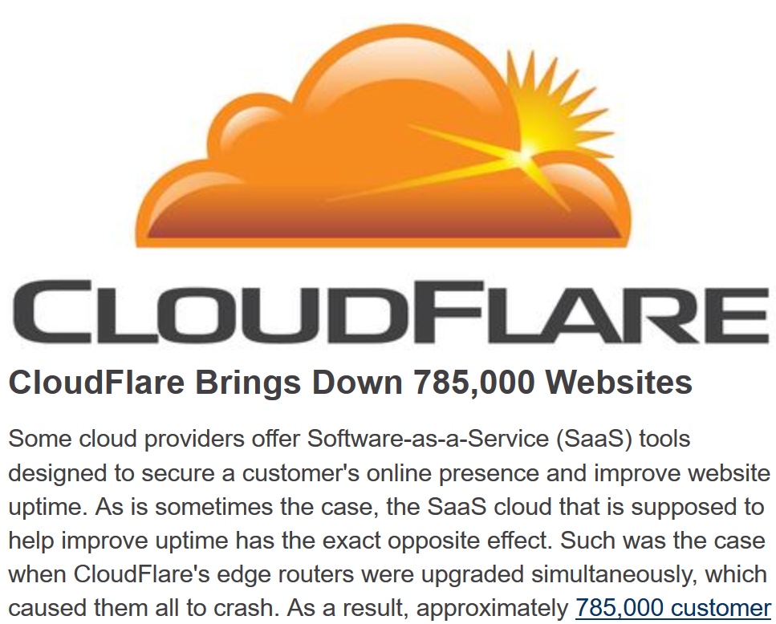
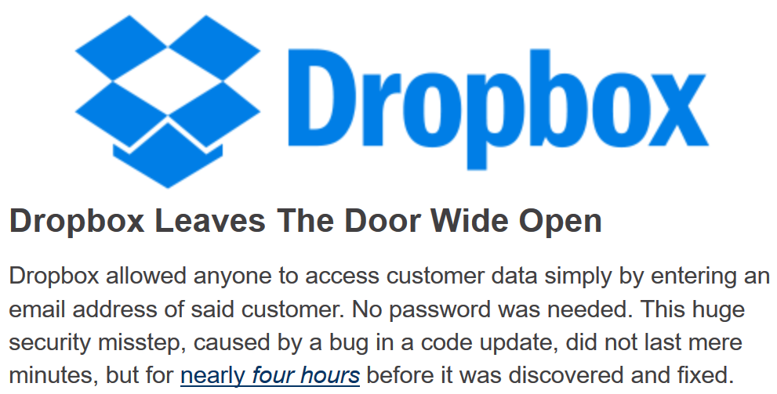
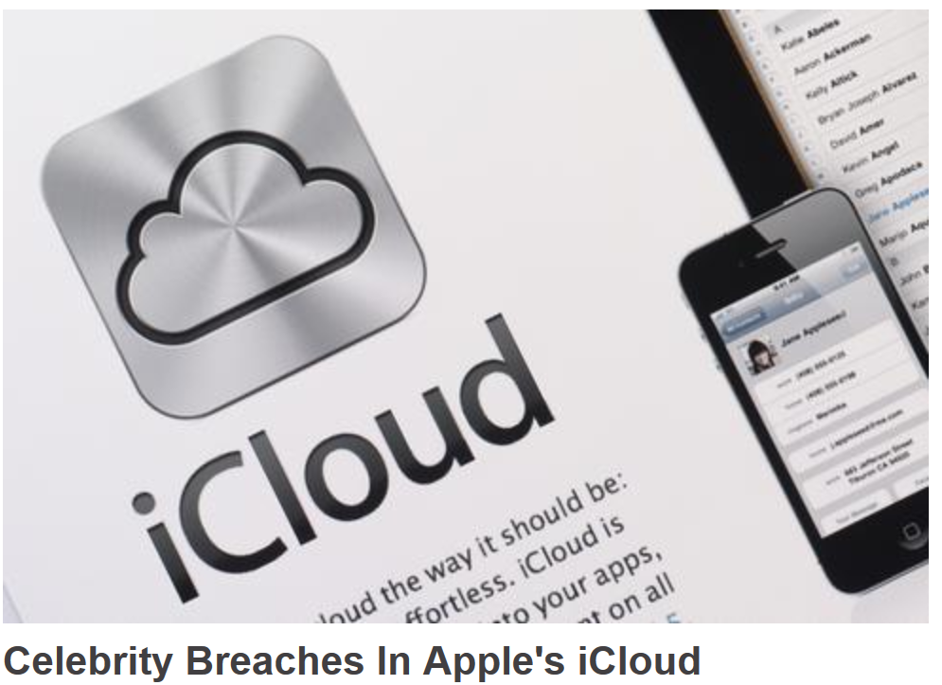
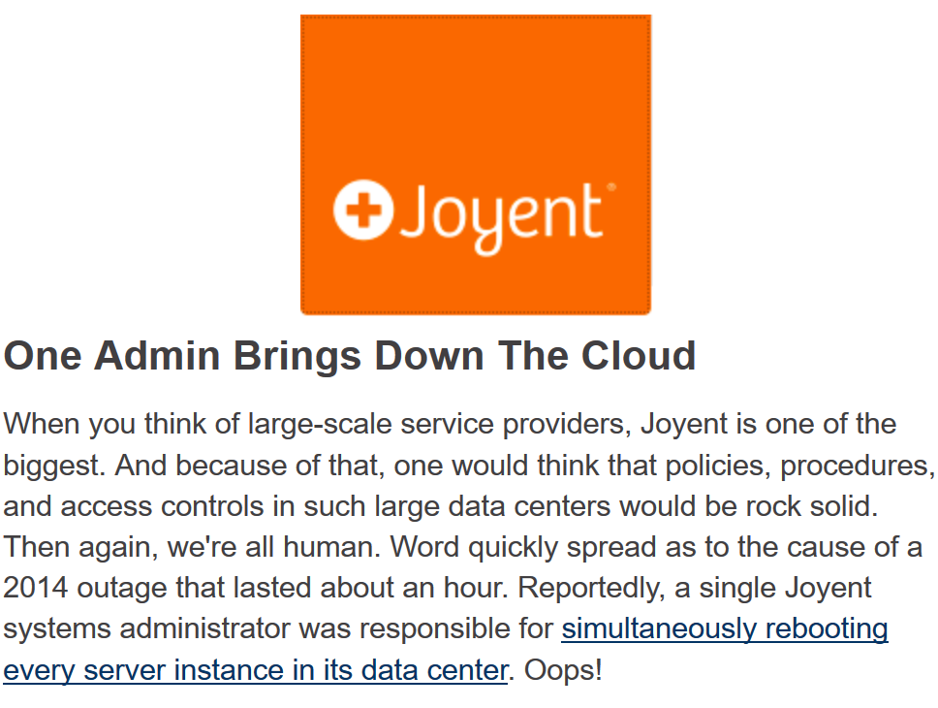
Cloud Security Realism
“The more things change, the more things remain the same”
“Through 2020, 95% of cloud security failures will be the customer's fault.” -Gartner
30% of Docker images have high level of security vulns
CSPs started w/ operational fails in resiliency
Mistakes happen. Humans still run the cloud
Obfuscated security via security certifications
AWS, Salesforce, Microsoft, Google, Verizon have all had problems maintaining uptime
Misconfigurations, poor ACLs, rogue changes can still happen
Most placated by certs; no real understanding on security
Included Shellshock & Heartbleed
CSPs will continue to drive efficiency in their infrastructure while transferring risk to customers.

Slide 11
Holding CSPs Accountable
People, process, technology considerations
People: Look at turnover & industry reputation for IT personnel
Do you know the culture at your CSP where you have your business running?
Culture helps abide to key processes in change control, incident response, secure DevOps, & other key processes
Process:
Understand their responsibility matrix
Vendor reviews can should be done against CSPs (bake into MSA)
Compliance based certifications as well; some better than others
Good Certifications (ISO 27001, FedRamp, PCI-DSS)
‘Meh’ Certifications (SSAE 16, Privacy Shield, other self certs)
Contractual Agreements
Technology
See their security evidence of pen testing
Test and test often (e.g. – pen testing, web app testing, etc.)

Slide 12
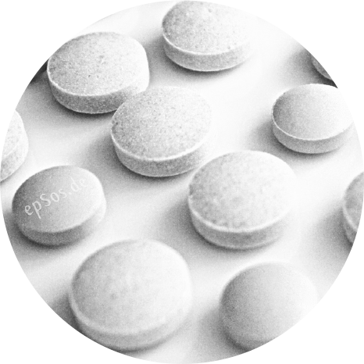
Balancing Security Accountability
Cloud security will ultimately be up to consumers
Metrics around cloud ops
Security testing across layers
Incident/ event monitoring
Information mapping & governance
Integrated architecture insight
Audit & reporting
Business impact analysis
Crypto & other key control implementations
Insiders/ human error

Slide 13
Rise of the APIs
REST, JSON, SOAP facilitate data exchange known by few and managed by fewer.

Slide 14
Proliferation of APIs Warrant Vigilance
Data exchanges can easily get out of hand
Application Programming Interfaces
Generally over HTTPS using JSON, SOAP, and REST data interfaces
Can be run as authenticated or anonymous auth models
Interfaces support multiple different method calls
Can be public or private
Be wary of zombie APIs
APIs becoming de-facto data exchange
Mobile clients hit exposed APIs
Greater integration with 3rd parties
OpenID Auth, Content partners
Partnerships w/ Federal governments and Big Business
Critical Security Areas
Places emphasis on good crypto
Privilege level is critical; who is making the programmatic calls?
RBAC model for end users
Audit trails and monitoring
Cloud related network ACLs

Slide 15
DevOps, APIs, and Your Data
How Architecture and Data Classification must be at the forefront of your Cloud related operations.
1. Inspecting DevOps
2. API Security
3. Data Architecture
Defining system images. Managing configurations via manifests. Testing 3rd party frameworks/ libraries. Locking down system, application, and DB accounts, environment hardening, pre-emptive compliance.
Leverage secure frameworks, build security & privacy-into design model, manage good crypto (encryption + hashing), govern API endpoints, CRUD exercises for API actors, integrated
Data Retention Policy for Apps & DBs. Crypto considerations for data at rest | transit, Data Flow Diagrams (DFDs), embracing PIAs for data governance for Cloud based APIs

Slide 16
Prescriptive Privacy Guidance for Cloud Adoption
Best practices to limit data loss and data mishandling

Slide 17
Privacy Considerations to Live By
21st Century big brother data collectors
Business Need to Know
Important for companies to conduct PIAs to validate their product groups need to know and be held accountable
Demonstrate relevance to pre-existing business objectives
Approved/ Authorized Use
Have the users provided consent?
Have they been made clear in terms of data usage of PII?
Has the PII been explicitly defined?
Retention
How long is the data needed to be retained?
Storage periods: in-memory, online storage, off line storage
Minimize liability by using and then discarding if not legally needed or required by business
Ensure Protection
Controls aimed for cryptographic storage of PII
Should review security controls associated with DFD

Slide 18
Top Threats to Consider
More of the same, but more sophisticated
Reason Old Threats Still Successful
Web technologies carry much of the OWASP Top 10 that still apply
Data pilfering still leading threat motive (1. Healthcare 2. Hospitality 3. Higher Ed 4. SMBs 5. Retail
Exploiting Old Weaknesses
Frameworks facilitate obfuscation of security
Micro frameworks negate many security libraries found in fuller web application frameworks
Injection based flaws: XSS, SQLi, CSRF
Implicit Trust Models (Company A Web API Trusts Company B Web API)
Poor Access Control (RBAC) Models
Negligible Audit and Monitoring Controls
New Threats
Dishing (introducing contaminated images or containers)

Slide 19
Best Practices in Managing Privacy/ Security in Cloud Operations
Governance
Assess risk
Visibility around risk issues need to happen vertically & horizontally
Risk issues need to correlate to business impact areas & Threats to the organization
Attack surface
Manage risk
Companies need to know their it footprint and often did not know the extent of their it, physical, or vendor footprint
Risk issues need ongoing management where assessments feed a risk register
Threat analysis
Remediate & Measure
Knowing today’s threats & how they relate to a company’s highest target areas is key
Remediation efforts should be measured & measured against key risk indicators to show progress

Slide 20
Mitigating Risk Through Negotiation
Limitation of damages liability provisions
Insurance
Compliance audits
Security requirements
Subcontracting
Access monitoring

Slide 21
Examples
IN NO EVENT SHALL VENDORS OR ANY OF ITS SUPPLIERS’ AND LICENSORS’ TOTAL AGGREGATE LIABILITY UNDER THIS AGREEMENT EXCEED THE TOTAL AMOUNT OF FEES RECEIVED BY VENDOR FROM CUSTOMER UNDER THIS AGREEMENT IN THE THREE (3) MONTH PERIOD PRECEDING THE EVENT GIVING RISE TO THE CLAIM.
The exclusions and limitations in this Section 10 shall not apply to:
a. Losses arising out of or relating to a party’s failure to comply with its obligations under Section 8 (Confidentiality), Exhibit “C” (Data Privacy and Security Requirements) or the Business Associate Agreement between the parties.

Slide 22
At all times during the Term and for a period of three (3) years thereafter, Vendor shall procure and maintain, at its sole cost and expense, all insurance coverage required by applicable law and in any event insurance coverage in the following types and amounts:
a. Cyber Liability Insurance, including first party and third party coverage with limits no less than $2,000,000.00 per occurrence and $5,000,000.00 in the aggregate for all claims each policy year.

Slide 23
Subcontracting
Vendor shall not subcontract any Services, in whole or in part, without Customer’s prior written consent, which consent shall not be unreasonably withheld or delayed. Without limiting the foregoing:
a. Customer’s consent to any such Subcontractor shall not relieve Vendor or its representations, warranties, or obligations under this Agreement.
b. Vendor shall remain responsible and liable for any and all (i) performance required hereunder, including the proper supervision, coordination and performance of the Services; and (ii) acts and omissions of each Subcontractor (including such Subcontractor’s employees and agents), are deemed Vendor’s acts and omissions to the same extent as if such acts or omissions were by Vendors.
c. Any noncompliance by any Subcontractor or its employees or agents with the provisions of this Agreement or any Service Order will constitute a breach by Vendor.

Slide 24
EXHIBIT C
DATA PRIVACY AND SECURITY REQUIREMENTS
In addition to any other data or Protected Health Information (“PHI”) requirements stated in the Agreement, Vendor agrees to the following:
Confidential Information
HIPAA compliance (BAA)
Specific security measures (i.e., access, monitoring, reporting)
Access to system by vendor
Security questionnaire
Redundancy
Data Back-up
Disaster Recovery

Slide 25
Questions?

