Slide 1
Research Overview of
Cybersecurity Centers (CyberDNA & CCAA) at UNC Charlotte
Ehab Al-Shaer
Director of Cyber Defense & Network Assur ability Center and
NSF Center on Security Configuration Analytics and Automation
University of North Carolina charlotte
College of Computing and Informatics ealshaer@uncc.edu

Slide 2
8 Reasons for Asymmetry in Cyber Warfare
Exponential Attack surface: Adversaries has to find one hole (vulnerability, misconfiguration, path), while defenders must block all holes.
Static Attack Surface Adversaries has plenty of chances to explore their targets and plan their attack (via do reconnaissance and fingerprinting), while defender has hard time predict attack attributions, and TTPs.
Adversaries (APT) has usually plenty of time and resources to execute their attacks, while attack mitigation is high slow and expensive
Systems complexity continue to grow tremendously, while analytic tools are limited with computational and space explosion (e.g., IoT and CPS analytics).

Slide 3
8 Reasons for Asymmetry in Cyber Warfare
Attackers have been freely and efficiently collaborating and sharing (dark web), while threat information sharing is hard to constitute, make-sense and actuate.
Hacking is a big-time money making, while cybersecurity is hard to sell (as it is not a commodity).
As hacking is highly attractive for recruitments, cyber education is slow in speed and low in bandwidth.
Adversary can attack but (so far) defenders can not counter-attack

Slide 4
Our Research Goal
Automating Cyber Defense from sense-making through decision-making to reverse this asymmetry in cyber warfare.
Research Topics (selected) includes
  Cyber Deterrence, and moving target defense == Mutable cyber
  Cyber Deception
  Automated configuration analytics – from Policies or STIX to Action
  Data-driven Security for automated cyber threat intelligence
  Auto-Resiliency
  Course-of-Action automation and orchestration
Domains
  Cyber and Software Defined Networks
  Cyber-Physical System security and resiliency (Smart grid and ICS)
  Cloud and Data Centers
  Internet of Things and smart things
  Mobile devices and networking
  Web application, VM and OS security
Sponsors: NSF, NSA, ARO, AFRL, BAC, DTCC, Wells Fargo, BB&T, Duke energy, IBM, Cisco, Intel, and others.
Attend the talk for details on Cybersecurity Research at UNC Charlotte

Slide 5
Research Areas/Topics
Security Configuration Analytics
  Configuration Verification
  Misconfiguration Detection and Diagnosis
  Planning and optimization
  Data center and Cloud configuration analytics
Cyber-Physical Security
  Smart Grid proactive security analytics and diagnosis
  Smart Grid reactive security analytics and recovery
  Air traffic controller security
Moving Target Defense
  Random Host IP Mutation (RHM)
  Random Route Mutation (RRM)
  Random Wireless AP Mutation
  Virtual Networks and Overlay Mutation

Slide 6
Research Areas/Topics
Active Cyber Defense and Deception
  Fingerprinting Deception
  Deception Synthesis and Planning
  Web Application Deception
Cyber and Critical Infrastructure Resiliency
  Metrics
  Resiliency Verification
  Resiliency by Construction & resiliency by refinement

Slide 7
Academic-Industry-Government Consortium for Advancing Cybersecurity Intelligence, Resiliency and Management
NSF IUCRC Center for Configuration
Analytics & Automation (CCAA)
Information Slides to Encourage Your Organization
to Join Us in CCAA
Check CCAA websites @ http://www.ccaa-nsf.org

Slide 8
Background
In May 2013 the National Science Foundation (NSF) established
NSF Industry/University* Center for Configuration Analytics and Automation (CCAA)
CCAA Vision:
The Center for Configurations Analytics and Automation (CCAA) vision is to build the critical mass of inter-disciplinary academic researchers and industry partnerships to undertake pre-competitive research that addresses the current and future challenges of enterprise analytics and automation.
* See information on this and other NSF national I/UCRC research efforts at http://www.nsf.gov/eng/iip/iucrc/

Slide 9
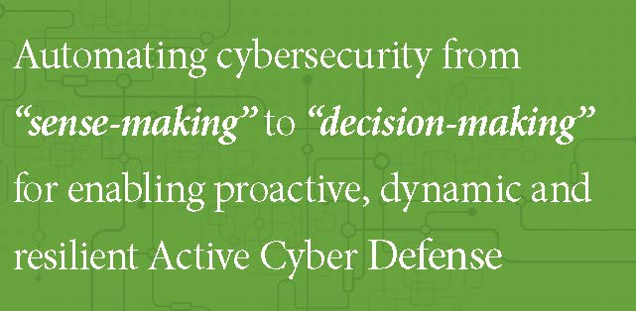
CCAA Mission
For more information, please visit WWW.CCAA-NSF.ORG

Slide 10
Collective Research Efforts Needed to Address the Gap Between CyberSecuirty Risks and Defensive Management Capabilities
Systems complexity Increasing
  Bigger attack surface
Systems are more integrated
  More Opportunity for Misconfiguration
“Internet of Things” – more connectivity
  More Exposure and Big Data
Increased Adversary Sophistication
  Better Defensive Measures Required

Slide 11
NSF I/UCRC Research Consortium Model
Industry & Government Organizations
- Join the CCAA Consortium as members
- Help Define and Guide the Multi-University Research Projects
- Share in the Intellectual Property Developed
Universities
- Establish CCAA research center
- Propose research projects
- Direct and manage research and develop students
NSF
- Provide administrative funding for CCAA Universities
- Provide independent evaluation of research efforts
Research Innovations

Slide 12
Public-Private-Academic Consortium for Addressing I&T Challenges Security A&A
CCAA
Academics
Government
Industry
Tech Transfer
Guided Innovation
Financial
Energy
Integrators
Vendors
startups
- Agencies
- National labs
Community-driven vision
best practices & standards

Slide 13
CCAA
Value
Proposition
High
Value
Low
Cost
Public-Private Partnership
Dual Benefit
Critical Mass Builder
Future workforce Pipeline

Slide 14
Value Proposition
High value –cutting edge and high-impact applied research in security analytics, automation, agility, resiliency and regeneration, to produces tools and prototypes that are easy-to-customize and integrate. The research is collectively steered, driven and owned by the industry members.
Low cost – The membership fees is very low, and granted full access and shared ownership to entire research portfolio.
A Critical Mass Builder –horizontal integration among researchers and SME of different academic and research institutions.
A Future Talent Workforce Enabler –a means to provide a hiring pipeline for high-end students.
A Public-Private Partnership Builder –strengthening private sector, academia, national labs and government collaboration in cybersecurity research.
Dual Benefit – CCAA innovation can directly benefit both private and USG capability development.

Slide 15
Inaugural CCAA Participants
NSF
Leverage research and development (R&D) investments with multi-university centers
Research Center sponsor is NSF Directorate for Computer and Information Science and Engineering (CISE)
CCAA Members
Financial Industry Companies
FFRDC (Federally Funded Research and Development Centers)
Universities
University of North Carolina at Charlotte (Lead University)
George Mason University, Fairfax, Virginia
Defense Companies
Government Organizations
See CCAA University Websites - http://www.ccaa-nsf.org

Slide 16
CCAA Research Site Directors
University of North Carolina at Charlotte
  Dr. Ehab Al-Shaer (email: ealshaer@uncc.edu)
George Mason University
  Dr. Sushil Jajodia (email: jajodia@gmu.edu)
Universities in Planning Phase
  Planning stage: Colorado State University (Dr. Indrakshi Ray)
Collaborating Universities
  University of Alabama (provenance-based authentication)
  Florida International University (mobile phone security)
  Georgia Tech
  UNC Chapel Hill
  Northwestern Univ

Slide 17
Research Recognition and Capability
Director of NSF Industry/University Collaborative Research Center on Configuration Analytics and Automation (CCAA, www.ccaa-crc.org) and Director of Cyber Defense and Network Assurability (CyberDNA) (www.cyberDNA.uncc.edu)
Research Expertise:
  Security Configuration Analytics and Automated Defense
  Cyber Agility (moving target defense)
  Objective Metrics for Security and Resiliency
  Security and Resiliency for Smart Grid
Featured as Subject Matter Expert (SME) in Security Configuration Analytics and Automation in DoD Information Assurance Newsletter, 2011.
Featured the prestigious IBM Faculty Research Award in 2012.
Member of the NSA Science of Security Lablet 2011-2013, and 2014-20117
Funding and Awards: ~$6,000,000 since 2009 and ~$3,000,000 as active funding from NSF, AFRL, NSA, ARO, Duke Energy, IBM, Cisco, Intel , Bank of America, BB&T, and DTCC.
Tools and Technology Transfer projects Cisco (INSPEC), Intel (Firewall Policy Advisor), Duke Energy (Threat Analyzer).

Slide 18
Security Automation Driven By Analytics is Essential
"The growth trends we've seen in cyber-attacks and malware point to a future where automation must be developed to assist IT security analysts.”
*Source: Dan Kaufman, director of DARPA's Information Innovation Office,
http://www.eweek.com/security/darpa-announces-grand-challenge-for-automated-cyber-defense.html/#sthash.1zD6Ua0M.dpuf

Slide 19
Science of Security Analytics and Automation
Analytics is to predict security threats and their impact (due to external threats or local misconfigurations) under incomplete system specifications and unknown attack strategies.
Automation is to dynamically adapting security controls and configurations to minimize risk (attack potential & consequences)
Analytics + Automation = intelligent, agile and proactive cyber defense.
Sophisticated attacks requires sophisticated defenses:
Predictive rather than Detective
  Proactive rather than Reactive
  Agile rather than Rigid
  Dynamic rather than Static
  Intelligent-driven rather than Human-driven
(automated) (manual)

Slide 20
Science of Security Analytics and Automation
Security Analytics Objectives are the modeling of:
  system/network behavior (configuration, logs, incidents etc.)
  adversary behavior, and
  user behavior, using system artifacts:
    Configurations: Rules and polices
    Traffic traces
    Meta-data and Logs and audits
    User audits
    Incident report and attack repositories
Security Automation Objectives are:
  Monitoring - collection and compliance check,
  Integration - unification/ontologies, standardization, reasoning,
  Response/adaptation (e.g., patching, dynamic reconfiguration, or agility)

Slide 21
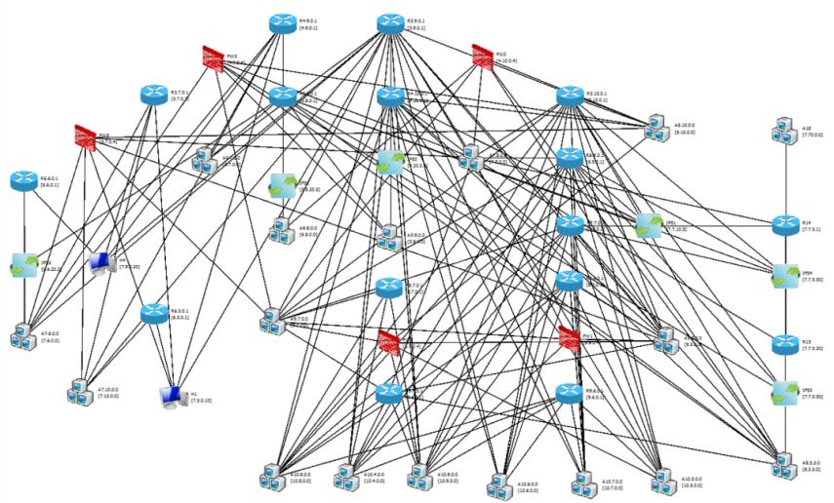
CCAA Landscape and Vision for Research Projects
Predominately Manual Management Practices
Security
Requirements
& Policies
Configuration Date
ANALYTICS
Logs and
Sensor Data
Defensive
Actions
Enterprise
Data Sensor
Incident reports
Configurations
Data Sensor
Analytics & Automation
Data Sensor
measurable Security
Security
Requirements &
Policies
Enterprise
Polices &
Configuration
Integration
Cost-effective Hardening
Automated Defense
Logs and
Sensor Data
Analytics
Automation
action
Defensive
Actions
System
Resiliency

Slide 22
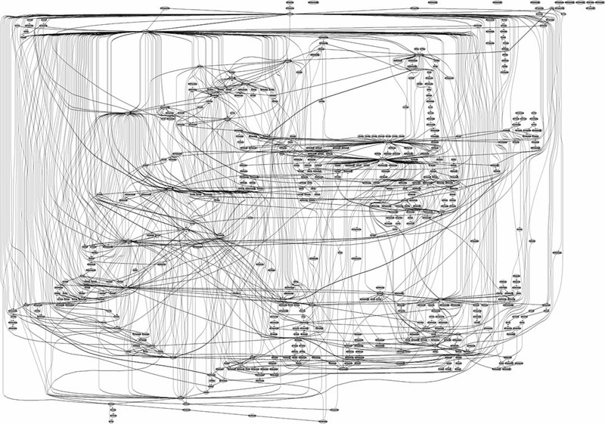
Things can get very messy very quickly ..
BIG networks, BIG data !

Slide 23
Key Challenges of Sensing-Making
Adaptive Information Sensing – how to collect it?
Information Correlation – how to determine inter-dependency?
  XCCDF and Configuration
  Evidential reasoning using STIX, DBIR, others
Information to Knowledge – how to apply/use it?
  STIX – priority/importance, filtering, impact,
  Cyber intelligence – ISP Neighborhood Watch, dark-web, mining and sematic search, attack visualization
  CVEs, CWEs, CAPECs, MITRE ATTACKS
Knowledge to Understanding – how to interpret it ?
  STIX- TTP enrichment, relevance
  PREDICT
Understanding to Situation-Awareness– how to contextualize it ?
  Impact on mission, attack root-cause analysis, residual risk, 0-day attack graph
Awareness to Metrics – how to measure it?
  Risk metrics (exposure, attackability), usability, security RoI, resistance, isolation, diversity
  Resiliency- resiliency in depth

Slide 24
Key Challenges of Decision-Making
Automated Cyber Hardening
  Defense Matrix
  Automated Risk Mitigation
Cyber Deterrence (proactive – pre-attack)
  Obfuscation/MTD – RHM, RRM
  Deception – fingerDeceiver, honeyBug
Cyber Resistance (reactive – during attack)
  Dynamic isolation and diversity
  Automated investigation and response (CoA Policies)
Cyber Auto-regeneration (reactive – post-attack)
  MoveNet
Active Cyber Defense: automating

Slide 25
Key Challenges of Cybersecurity Automation
Goal: integrating sense-making and decision-making in a close-loop system to enable adaptive learning and evolving defense strategies, tactics and techniques (course of actions)
Approaches
  Decision and game theory
  Automated synthesis and planning
  Bayesian networks
Projects: CDM, ARHM, XCCDF-ROI, MoveNet

Slide 26
Join the Current Members
University of North Carolina at Charlotte
  National Security Agency
  Bank Of America
  Depository Trust & Clearing Corporation
  RTI International
George Mason University
  MITRE
  North Grumman
  Office of Naval Research (ONR)

Slide 27
Membership Requirements
Industry or Government Organizations
  Yearly minimum membership $50,000* (Government organizations can MIPR funds directly to NSF for their CCAA membership saving administrative paperwork.)
  Members serve on CCAA Industry Advisory Board (IAB)
    Board meets twice a year to review and guide the research projects and directions of the CCAA
    Pre-publication review by members of any proposed published research.
    Any intellectual property developed can be use license fee free to members of CCAA.
* Invoiced typically in June of CCAA’s fiscal year, which is 1 July thru 30 June.

Slide 28
Current and Perspective Projects
Risk Analytics and Active Cyber Defense
  • Integrated Risk Analytics using XCCDF and Network Configuration
  • Real-Time Detection and Mitigation of Application-level Stealthy (Low and Slow) DDoS Attacks
  • Dynamic & Efficient Risk Mitigation Using XCCDF-based Risk Analysis
Cyber Resiliency and Cyber Intelligence
  • Cyber Agility for Proactive Defense
  • Hardening Network Configurations in the Face of Zero-Day Vulnerabilities
  • Multi-layer Cyber Resiliency and Agility
  • Active Cyber Deception
  • Automated STIX Enrichment and Generation
Optimal Decision Making for Cyber Risk Mitigation
  • Cyber Defense Matrix
  • Objective Evaluation of the top 20 Critical Security Controls
For more information, please visit WWW.CCAA-NSF.ORG

Slide 29
Current and Perspective Projects
Secure and Usable Novel Identity Management
  • Analytical Verification of Cloud Configurations by Users
  • Authentication using Visual Analytics and Interaction Provenance
Web, Mobile and Software Security Analytics
  • Fortifying Event Mechanisms on Smart Phones as a Service
  • Mitigating Malicious Application Logic through Build Assurance
  • Web Application Defense by Mystification
Configuration Security Analytics
  • A Course on Certified Ethical Hacking
  • An Ontology Based Methodology for Analyzing Web Application Firewall Rules
  • Developing and Evaluating Serious Video Games for Cultivating High Level Cybersecurity Expertise
For more information, please visit WWW.CCAA-NSF.ORG

Slide 30
CCAA Key Challenges Project Metrics
Provablity – cyber assurability by design
Measurability – metrics to measure security and insecurity
Predictability – attacks, strategies and impact
Resiliency – protecting the integrity mission during and after attacks
Automation – human is ON or OFF the loop!
High-capacity Talent Pipeline– programs to graduate high quality in a short time.

Slide 31

CCAA Projects Address Cybersecurity Challenges
 | Risk-Mitigation XCCDF | Multi-layer Resiliency | IMPACT | S&L DDoS | CDM | Attack graph | Cloud secure | Secure vehicle | Ethical hacking
Provability
Measurability
Predictability
Resiliency
Automation
High-capacity Talent Pipeline

Slide 32
Benefits of CCAA Membership
Create, direct and leverage specific pre-competitive research efforts required in this field that can benefit your organization.
Influence ongoing research quality and future research efforts through annual member advisory board reviews conducted twice a year.
Develop and foster new industry-to-industry and industry-to-government relationships and opportunities through interaction with industry, academic and government key players in the field.
Gain advance knowledge of research results as they emerge.
Have access to students and researchers who may fulfill critical resource needs within member organizations.
Participate in a historically successful NSF approach that advances important capabilities needed by critical elements of societies.

Slide 33
Please Consider Becoming a Member of CCAA
Your efforts would be invaluable to our collective efforts to advance needed research guided by your organizations leadership.
Contact either for additional information:
  Dr. Ehab Al-Shaer, UNC Charlotte, ealshaer@uncc.edu (704) 687-8663

Slide 34
CCAA Project Overview

Slide 35
Dynamic Cost-Efficient Risk Mitigation Using XCCDF and Configuration Analytics
PI: Dr. Ehab Al-Shaer
Researchers: Mohamed Alsaleh and Ghaith Husari
University of North Carolina Charlotte
ealshaer@{uncc.edu,ccaa-crc.org}
{malsaleh, ghusari}@uncc.edu
Notes:
As the title suggests, in this project we aim at providing security analytics that augment the host compliance reports with network configuration in order to provide a holistic view of the system.

Slide 36
Overview
We defined metrics to measure the enterprise risk.
  Network Configuration (exposure).
  Compliance reports (exploitability and impact).
Mitigation planning.
  Considers only patching vulnerabilities and network reconfigurations.
  Resistance of countermeasures is static.
XCCDF Reports
Network Configuration
Risk Estimation
Risk Mitigation
Patch Vulnerabilities
Reconfigure

Slide 37
Objectives
Current Phase
What is the subset of vulnerability fixes and/or reconfigurations that can limit Residual Risk under specific budget constraint?
Next Phase
What is the impact of an XCCDF violation on the enterprise resilience?
Notes:
XCCDF are evaluated for individual hosts separately. We are correlating the network-wide compliance reports with the global network configuration to provide top-down and bottom-up analytics.
In the previous work, the top-down, we verify that the configuration and the compliance state of the network satisfies a given policy.
In the bottom-up approach, our goal is to devise cost-effective risk mitigation utilizing the compliance reports of the network.

Slide 38




Risk Mitigation Planning
Internet
Network Topology
CVE-2015-4760
CVE-2015-2146
CVE-2015-4760
CVE-2015-2146
CVE-2015-7310
CVE-2015-7310
Network Compliance (XCCDF)
Business Model
Fix Vulnerabilities
Apply Resistance
CVE-2015-5600
Notes:
CVE-2015-4760
CVE-2015-2146

Slide 39
Overview of Hardening & Mitigation Options
 | Host-based Actions | Network-based Actions
Examples | Patch Restrict Reconfigure Disable | Isolate: block, encrypt, inspect.
Impact | Disruption/Satisfaction | Disruption/Satisfaction
Cost | Complexity | Complexity
Source | Provided by XCCDF documents and selected based on risk scores and cost. | Derived based on risk scores, cost, and satisfaction thresholds.
Notes:
This is a summary of the types of actions recommended by the mitigation planner.
As explained earlier,
Host based actions are applied to each host individually, while network based actions are applied to network devices.
The Impact of host based actions are measured based on the disruption value which the operational degradation. While the impact of network base actions is measured based on the effect it has on the service satisfaction by the users.
The cost for both types of actions is measured by the complexity which the difficulty of applying the actions.
And finally the source for the host based actions is the XCCDF authors. Where as, the network based actions are derived by the mitigation planner based on risk, cost, and satisfaction thresholds.
Just emphasize that this is a summary.
Go quickly over them by showing one to one comparisons.

Slide 40
Risk Mitigation Planning
Problem
  Given the XCCDF reports, business model (services), reachability matrix, and mitigation costs, our objective is to satisfy five criteria:
    Measure the global enterprise risk (R₀), and
    Find the minimum set of mitigations (vulnerability fixes and/or reconfigurations) such that
    The Global Residual Risk is NOT more than a given threshold (e.g., R < 0.5 R₀).
    The Server Residual Risk is NOT more than a given threshold (e.g., R^{i} < 0.5 R^{i}₀).
    The individual and global Service Satisfaction is NOT less than a given threshold (e.g., R^{s} > 0.5 R^{s}₀)
    The total Cost is less than the available budget.
    Policy requirements.
Notes:
The problem we are trying to solve in this approach is to find the best investment for a specific budget to mitigate the risk, given some restrictions. By best investment we mean, finding the minimum set of fixes to mitigate the risk without violating the given restrictions such as budget and policy requirements.
------------------
The problem we are trying to solve in this approach is to fine Find the best investment of a specific budget to mitigate the risk.
Starting on the current network state Given some restrictions.
Finding the min set of fixes to reduce the risk, starting on the current network state given some restrictions such as residual risk, service satisfaction, policy requirements

Slide 41
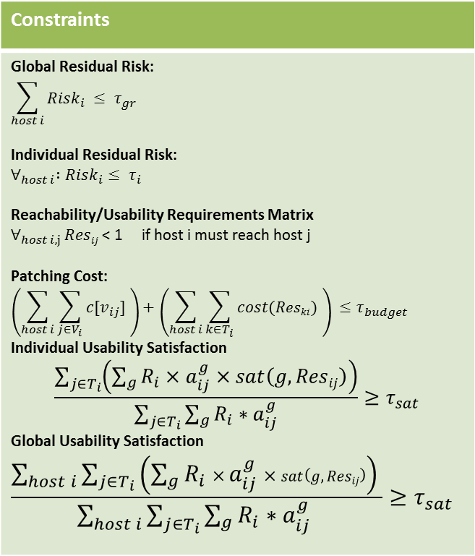


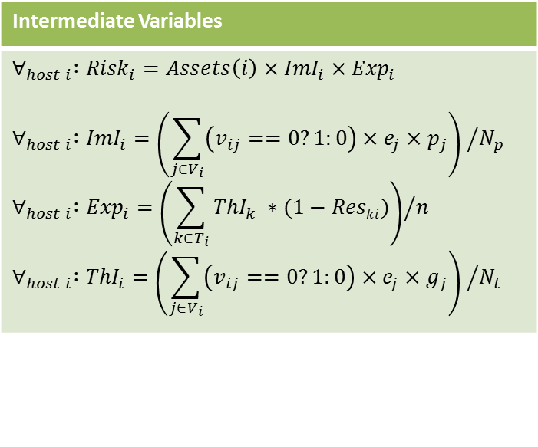
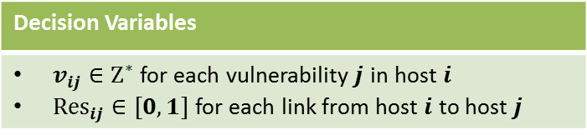
Mitigation Planning as Constraints Satisfaction Problem
Decision Variables
$v_{ij}∈Ζ^{∗}$ for each vulnerability$j$ in host $i$ ${Res}_{ij}∈[0,1]$ for each link from host $i$ to host $j$
Constraints
Global Residual Risk: $$\sum_{host i}{{Risk}_{i}} ≤ τ_{gr}$$ Individual Residual Risk: $$∀_{host i} :{Risk}_{i}≤ τ_{i}$$ Reachability/Usability Requirements Matrix $∀_{host i,j }Resij$ < 1 if host i must reach host j Patching Cost: $$\left(\sum_{host i}{\sum_{j∈V_{i}}{c[v_{ij}]} }\right)+\left(\sum_{host i}{\sum_{k∈T_{i}}{cost(Reski)} }\right) ≤τ_{budget}$$ Individual Usability Satisfaction $$\frac{\sum_{j∈T_{i}}{\left(\sum_{g}^{ }{{R_{i}×a}_{ij}^{g}×sat\left(g,Resij\right)}\right)}}{\sum_{j∈T_{i}}{\sum_{g}^{ }{{R_{i}∗a}_{ij}^{g}}}}≥τ_{sat}$$ Global Usability Satisfaction $$\frac{\sum_{host i}{\sum_{j∈T_{i}}{\left(\sum_{g}^{ }{{R_{i}×a}_{ij}^{g}}×sat\left(g,Resij\right)\right)} }}{\sum_{host i}{\sum_{j∈T_{i}}{\sum_{g}^{ }{{R_{i}∗a}_{ij}^{g}}} }}≥τ_{sat}$$
Intermediate Variables
$$∀_{host i} :{Risk}_{i}=Assets\left(i\right)×{ImI}_{i}×{Exp}_{i}$$ $$∀_{host i} :{ImI}_{i}={\left(\sum_{j∈V_{i}}{\left(v_{ij}==0?1:0\right)}×e_{j}×p_{j}\right) }/{N_{p}}$$ $$∀_{host i} :{Exp}_{i}={\left(\sum_{k∈T_{i}}{{ThI}_{k} ∗(1−Reski)}\right)}/n$$ $$∀_{host i} :{ThI}_{i}={\left(\sum_{j∈V_{i}}{\left(v_{ij}==0?1:0\right)}×e_{j}×g_{j}\right) }/{N_{t}}$$
$cost(Reski)$: Resistance → Cost
$sat\left(g,Resij\right)$ : Resistance → Satisfaction
Notes:
- Add labels for the constraints.

Slide 42





Mitigation Planning: Current Approach
Vulnerability Information (XCCDF Documents)
Network Topology and Configuration
Host | Vulnerability | C | I | A | Exp
H1 | CVE-2015-4760 | 0.275 | 0.275 | 0.66 | 8
 | CVE-2015-7310 | 0.66 | 0.66 | 0.66 | 10
H2 | CVE-2015-5600 | 0.275 | 0.275 | 0 | 8
Constraints
Host-based Fixes
Vulnerability |  | Fix | Cost |  | Disruption
CVE-2015-4760 |  | Fix-1 | 250 |  | 0.78
 |  | Fix-2 | 0.66 |  | 0.48
CVE-2015-5600 |  | Fix-1 | 0.275 |  | 0.3
Network-based countermeasures
Countermeasure | Resistance |  |  | Cost | Disruption
Firewall | 1 |  |  | 100 | 0.8
IDS | 0.5 |  |  | 200 | 0.3
Global Residual Risk.
Budget.
Service Satisfaction (Usability)
Mitigation Planning Engine
Mitigation Plan
Host-based Mitigation
Host | Vulnerability | Recommendation
H1 | CVE-2015-4760 | Patch
 | CVE-2015-7310
H2 | CVE-2015-5600 | Patch
Network-based Mitigation
Host | H1 | H2 | H3
H1 | Res=0.98 | Res=1
H2 |  |  | Res=0.6
H3 | Res=0.4

Slide 43
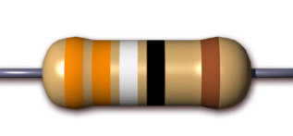













Limitations
Network
Countermeasures
Weaknesses
Attacks
Different hosts have different vulnerabilities
Different attacks targeting different vulnerabilities
Which countermeasure provide the required resistance?

Slide 44



Limitations or Current Implementation
The resistance measures effectiveness is fixed.
  Same measures may have different resistance for different hosts.
  Based on the vulnerabilities.
Countermeasure | Resistance
Firewall | 1.0
IDS | 0.5
IPSec (Encryption) | 0.7
Other in the network | …
CWE-20: Improper Input Validation
Detection Methods: Inspection
ts
CWE-326: Inadequate Encryption Strength
Use a cryptographic algorithm that is currently considered to be strong by experts in the field.
Target
2
Target
1
CWE-326: Inadequate Encryption Strength
CWE-20: Improper Input Validation

Slide 45
Mitigation Planning: Revised Approach
Vulnerability Information (XCCDF Documents)
Network Topology and Configuration
Host | Vulnerability | C | I | A | Exp
H1 | CVE-2015-4760 | 0.275 | 0.275 | 0.66 | 8
 | CVE-2015-7310 | 0.66 | 0.66 | 0.66 | 10
H2 | CVE-2015-5600 | 0.275 | 0.275 | 0 | 8
Constraints
Host-based Fixes
Vulnerability |  | Fix | Cost |  | Disruption
CVE-2015-4760 |  | Fix-1 | 250 |  | 0.78
 |  | Fix-2 | 0.66 |  | 0.48
CVE-2015-5600 |  | Fix-1 | 0.275 |  | 0.3
Network-based countermeasures
Countermeasure | Resistance |  |  | Cost | Disruption
Firewall | 1 |  |  | 100 | 0.8
IDS | 0.5 |  |  | 200 | 0.3
Global Residual Risk.
Budget.
Service Satisfaction (Usability)
Mitigation Planning Engine
Vulnerabilities | Host-based Fixes | Network Mitigations
 |  | FW | IDS | VPN | …
CVE-2015-4760 | Fix-1
 | Fix-2
CVE-2015-5600 |  | 1 | 0.6 | - | …
Mitigation Plan
Host | Vulnerability | Recommendation
H1 | CVE-2015-4760 | Patch
 | CVE-2015-7310
H2 | CVE-2015-5600 | Patch
Host | H1 | H2 | H3
H1 | Res=0.98 | Res=1
H2 |  |  | Res=0.6
H3 | Res=0.4

Slide 46


Challenges
XCCDF
CVE
Mitigation Actions
How to identify countermeasures based on vulnerabilities.
No structured data repositories to associate mitigation actions with vulnerabilities.
Depends on human judgement.

Slide 47





How to accomplish this?
Create a taxonomy of all countermeasures against pre and post attack exploitation and post attacks from CAPEC and MITRE Attack repositories.
Estimate the effectiveness of these countermeasures against the attack techniques.
Map the vulnerabilities to the attack techniques that rely on them.

Slide 48

Research Approach: Threat-Vulnerability Dependency
CVE-2008-3060
CVE-2008-4638
CVE-2007-5172
CVE-2009-2960
CVE-2008-2374
CVE-2008-2049
CVE-2009-2282
Attack Scenarios
CVE-2008-2049
CVE-2008-3060
Attack Scenarios Generator
CVE-2008-2374
CVE-2007-5172
CVE-2009-2960
CVE-2009-2282
Reconnaissance | Weaponization | Delivery | Exploitation | Installation | C2 | Actions
CVE-2008-4638
Kill Chain Phases

Slide 49
Current Research Tasks
Mapping countermeasures to weaknesses.
  Evaluate the countermeasures effectiveness.
  Compare and select the most effective countermeasures.
Understand the dependency between vulnerabilities with respect to kill chains.
  Tune our mitigation to assign more weights for central vulnerabilities.
Resiliency/Mitigation planner testing using simulation & (possibly) real data.

Slide 50
CCAA Project:
Automated Multidimensional
Decision-Making for Cyber Risk Mitigation (CyberARM)
PI: Ehab Al-Shaer
Researchers: Ashutosh Dutta, and Qi Duan
University of North Carolina AT Charlotte
ealshaer@uncc.edu

Slide 51
Problem Definition
The Cyber Defense Matrix (CDM) determines the selection of security controls in an enterprise based on a multidimensional matrix that includes:
  (1) security function (identify, protect, detect, respond and recover) ,
  (2) enforcement level (people, network, device, application, data), and
  (3) kill-chain phase (recon, weaponize , deliver, exploit, control, execute, and maintain).
CyberARM is a theoretical framework and tool for selecting and composing security controls for optimizing CDM in order to obtain the cost-effective risk mitigation planning (i.e. lowest affordable risk).

Slide 52
Project Objective
Computing the set of security controls and corresponding technologies that can guarantee a bounded residual risk under budget constraints, given the VERIS data, available technologies, and their effective measure on enforcing CSC.
Multi-layer defense for enabling cyber resiliency against single-point of failure/attacks.

Slide 53
Accomplishments since April 2016
Expanding the dimensionality of CDM to consider Kill Chain and Security Control
Classification of Security Controls (NIST and CSC) based on kill chain and enforcement levels.
Estimation of likelihood of a threat against an asset using VERIS incident data:
  Analysis of VERIS Community Database (VCDB).
  Formulation of “Threat Estimating Likelihood (TEL)” for a particular asset using VCDB.
    A low hanging-fruit application: Threat classification and prioritization for an asset.
Designing a new data and workflow models for representing CDM considering many to many relationships of the CDM dimension
  The new data model using extended Entity-Relationship graph Diagram.
Theoretical foundation for CDM Optimization (for an asset):
  New metric for measuring probability of a successful attack.
  Choosing set of technologies.

Slide 54
Enhancement of Cyber Defense Matrix (CDM)
Phases of kill-chain has been introduced as the 3rd dimension of CDM.
Each class of security controls has now three attributes: Kill-Chain Phase, Enforcement Level,
Security Function(SF).
Enforcement
level
Maintain
Execute
Control
Data
Exploit
Application
Device
Deliver
Network
Weaponize
People
Recon
Security
Function
Identify
Protect
Detect
Respond
Recover
KC Phase

Slide 55
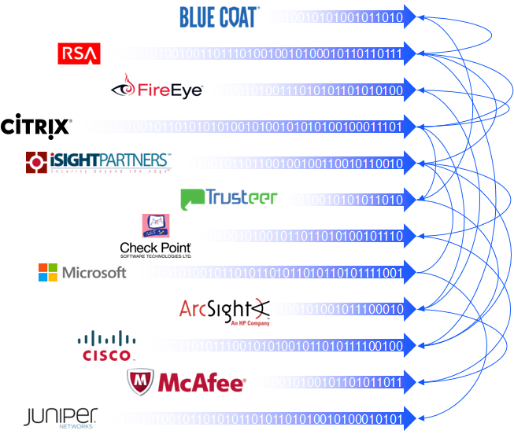
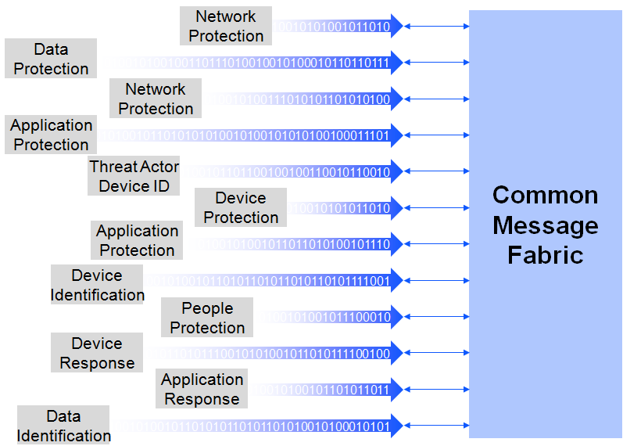
Common Language 2
What products talk to each other today
Automation
Integration

Slide 56
Expanding the Dimensionality of Cyber Defense Matrix
Security controls used as the basic countermeasures for risk mitigation and defending cyber assets against threats.
Using the new dimensions: $CDM vector<x, y, z>$ is a set of Security Controls that provides the Security Function $z$, at the $y^{th}$Enforcement level, during the $x^{th}$ phase of kill-chain to defend a particular asset from a set of threats.
  Technology solutions can be evaluated and objectively mapped (with weights) to one or more security controls implemented by these solutions.
  The optimal set of technologies that implements the SC will be selected based on its effectiveness, cost and threat likelihood it defends.

Slide 57
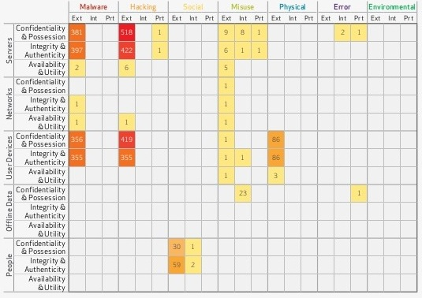
Overview of VERIS/DBIR
VERIS Community Database (VCDB) contains data of recorded and shared security incidents.
We are developing a tool that can categorize (prioritize) security incidents of VCDB based on threats, technique, asset type and asset domain.

Slide 58
Example of Mapping CSC to Security Function, Kill Chain,
and Enforcement Level (CSC-DefenseAction Mapping)
Security Control | KC Phase | Security Function | Enforcement Level
Automated Asset Inventory Discovery (CSC 1.1) | Recon | Identify | Network
Virtual machines (CSC 2.4) | Deliver | Protect | Application
URL Filters (CSC 7.6) | Deliver | Protect | Network
File Integrity Checking (CSC 3.5) | Maintain | Detect | Data
Vulnerability Scanning Tool (CSC 4.1) | Exploit | Detect | Network
Minimize Administrative Privilege (CSC 5.1) | Exploit | Protect | Device
Block Unnecessary Scripts (CSC 7.3) | Execute | Protect | Application
Continuous Monitoring Tool (CSC 8.1) | Maintain | Detect | Device
Automatic Backup (CSC 10.1) | Maintain | Recover | Application
Security Awareness Program (CSC 17.3) | Delivery | Protect | People
Centralized Authentication (CSC 16.9) | Control | Detect | Network

Slide 59
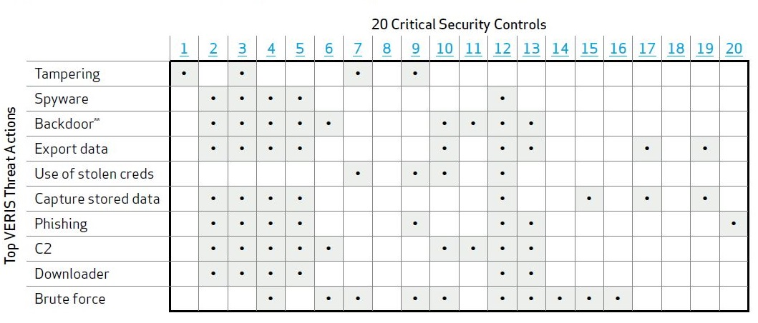
Example of Mapping CSC to Threat
In 2013 Verizon Data Breach Investigation Report, a mapping from CSC to VERIS threat actions has been included.
This mapping provides a coarse-grained description of the relationship.
We are trying to map each security control of a CSC to specific threat actions at specific KC phases.

Slide 60
Combining CSC-Threat-VERIS and CSC-DefenseAction Mapping Mapping
By combining both we can now know the mapping between threat actions in VERIS and the <KC, security function and enforcement level>.
Social engineering
Malware
Phishing
C2
Exfiltration
Backdoor
Spyware
1 | 2 | 3 | 4 | 5 | 6 | 7 | 8 | 9 | 10
<d,10%>
 | <d,10%>
 |  |  | <d,10%> | <d,10%>
 |  |  | <d,10%> |  |  | <d,10%>
 |  |  |  |  |  |  | <d,10%>

Slide 61
Estimation of likelihood of Threat
There are many different threats to asset in a specific business domain (e.g., finance, accounting etc.).
There are many techniques (vectors in VERIS) used by one threat and vice versa.
Using the chain rule, the probability of a successful attack due to a threat using a specific technique against an asset, a, is, $p(threat|a,technique)$:
$$p\left(threat | a,technique\right)= \sum_{i}{p}\left(threat | {domain}_{i}, a, technique\right)∗p({domain}_{i}|a, technique)$$
The probability of a successful attack due to a threat against an asset, a, is $p(threat|a)$
$$p\left(threat | a\right)= \sum_{i}{\sum_{j}{p\left(threat | {technique}_{i},{domain}_{j}, a\right)}}$$
$$∗p\left({technique}_{i} | {domain}_{j},a\right)$$
$$∗p\left({domain}_{j} | a\right)$$
Using this formula for a dataset (e.g. VCDB), we will get probabilities of all threats and based on the probabilities, we will prioritize threats for an asset.

Slide 62
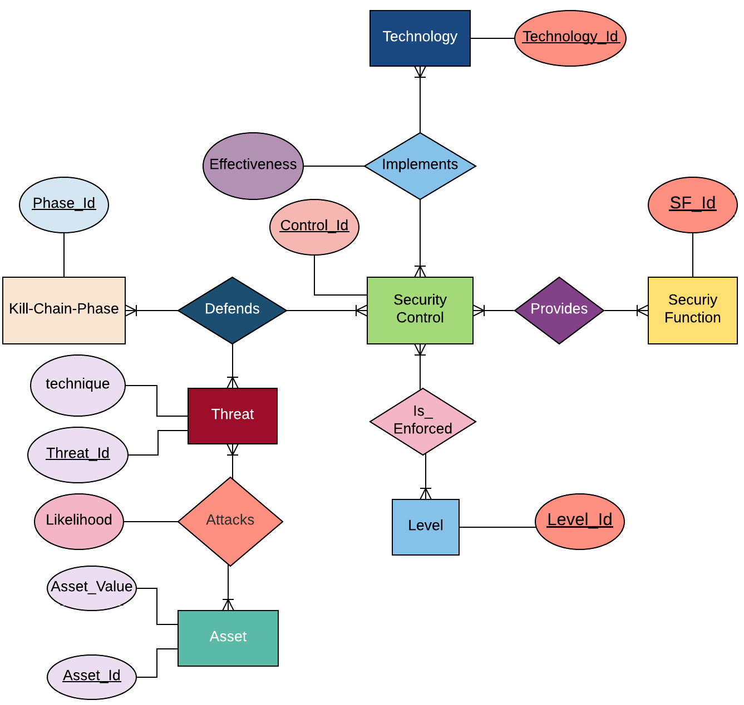
CyberARM Data Model
The new CyberARM model provides a clear visual representation of entities of CyberARM and their relationship with each other.

Slide 63
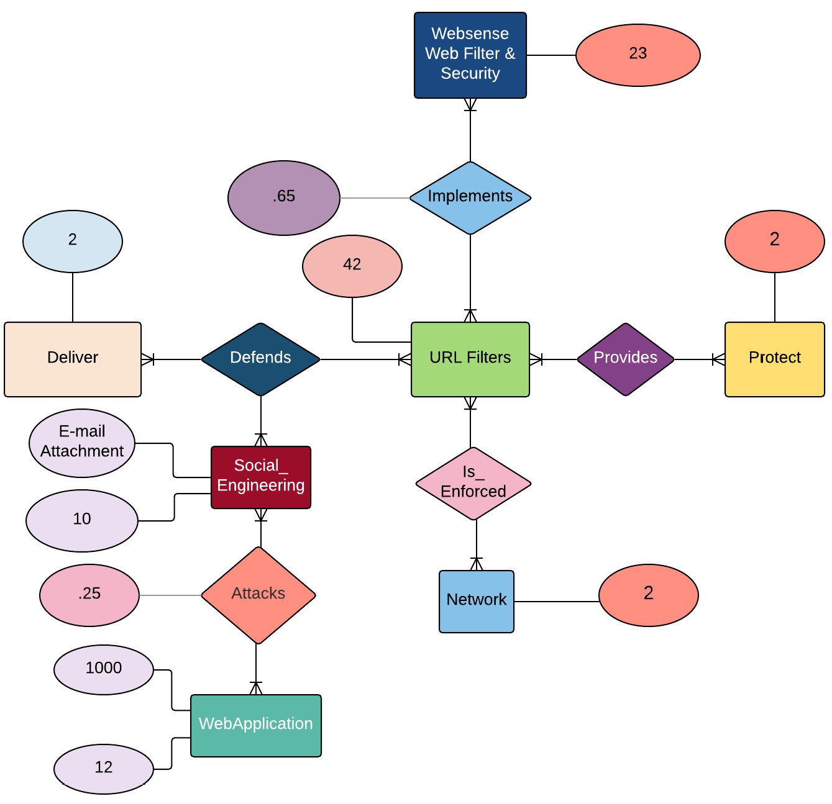
Example CyberARM Data Model

Slide 64
CyberARM Workflow Model
SC_Defends_
Threats
VCDB
Prioritize
Threats
Select
SC
Asset
Pr(Threat|
Asset)
SC
Find
Technol_ogy
Technology_
Implements_
SC
Asset_
Value
Threat
CyberARM
Engine
Technologies & effective measures
Optimized CDM

Slide 65
Example
Problem: Selection of most cost-effective set of technologies that will minimize risk of a
WebApplication.
CDM is the database of all security controls and technologies. In other words, CDM contains
all “Security Control (SC)” and “Technology” entities.
Prioritize Threats:-
  Which threats are more likely to happen against WebApplication?
  Every “Threat” object has three attributes: Threat_Id, Threat_Name, Technique_Name.
  Threat Entities:
Threat_Obj
Threat_Obj
Threat_Id = 1
Threat_Name = Hacking
Technique_Name = Backdoor
Threat_Id = 2
Threat_Name = E-mail
attachment
Technique_Name = Social_Eng.
Every “Asset” object has four attributes: Asset_Id, Asset_Type, Domain, Asset_Value.
Asset_Obj
Asset_Id = 1
Asset_Type = WebApp
Domain = Financial
Asset_Value = 10000

Slide 66
Example
From dataset of VCDB, list of “Threat” objects and list of “Asset” object, a list
of “Threat_Attacks_Asset” will be drawn that will map “Threat” entities to “Asset”
entities with probability.
Threat_Id | Asset_Id | Likelihood
1 | 1 | .38
2 | 1 | .25
3 | 1 | .10
4 | 1 | .05
  We will choose or prioritize threats based on defined threshold of probability.
  Let’s assume, Threat_Obj {1,2} will attack our asset.
Security Control (SC) Selection:
  Which security controls will defend these threats against the asset?
  From mapping of SC to Threats and Kill-Chain-Phase, we will have a list of
  “SC_Defends_Threat”.
  SC_Obj {1,2} will defend threats .
Threat_Id | SC_Id | KC Phase
1 | 2 | Control
2 | 1 | Weaponize

Slide 67
Example
  Security Control Object:
SC_Obj
SC_Obj
SC_Id = 1
SC_Name = URL_Filter
Security_Function = Protect
EF_Level = Network
SC_Id = 2
SC_Name = Anomaly_Based_
Detection
Security_Function = Detect
EF_Level = Device
Finding Technologies:
  Which technologies implement these security controls?
  Technology_Implements_SC Entities:
  So Technology_Obj{1,2,3} have defense against Threat_Obj{1,2}.
SC_Id | Technology_Id | Effectiveness
1 | 2 | 0.9
2 | 1 | 0.65
2 | 3 | 0.2

Slide 68
Example
Technology Entities :
Technology_Obj
Technology_Obj
Technology_Id = 2
Technology_Name = Websense Web Filter & Security
Security_Function = Protect
EF_Level = Network
Cost = 700
Technology_Id = 1
Technology_Name = AlienVault Unified
Security Mgmt.
Security_Function = Detect
EF_Level = Device
Cost = 1000
Input to CyberARM :-
  Now we have a list like this:
  From Technology_obj{1,2,3}, our CyberARM will choose set of technologies that will minimize risk for our given asset within a given budget.
  Optimized CDM is the subset of CDM. It will only contain “SC” entities that have been implemented by these “Technology” entities.
Threat_Id | Threat | Technique | SC_ Id | Technology_Id | Security_ Function | EF_Level | KC Phase | Effectiveness | Cost
1 | Social_ Eng | E-mail Attachment | 1 | 2 | Protect | Network | Weaponize | .65 | 700

Slide 69
Proactive Connection Blocking based on Cyber Threat Intelligence
By: Amirreza Niakanlahiji
Mir Mehedi Pritom
Bill Chu
Ehab Al-Shaer

Slide 70
What we did?
Techniques for malware to evade tracking
  Using DGA algorithm
  DNS Fast Fluxing
  Detection algorithm based on malware traffic trace

Slide 71
Current Objective
Neutralize malwares by proactively blocking C2 connections
Minimal impact on normal operation
  Low false positive
  Mission critical destinations should not be blocked

Slide 72
Hypothesis
Command and control systems are not scattered uniformly on Internet
  They tend to be close to each other
    Reusing infrastructure
    Negligence of service providers
    Different jurisdictions
      lack of laws about cyber-attacks
    …..

Slide 73
Feature – Shared hosting
Private vs shared hosting
  Shared hosting means more than one domain names are associated to the IP address of the host
  35 percent of hosts on Internet are shared hosts
  86 percent of C&C servers are on shared hosts
  TLD zone files
    From Verisign
    For .com and .net TLDs
    Contain DNS ns records

Slide 74
Blocking strategy Overview
Block /24 subnets
  With at least one known previous connection request from a malware within past x days
  Destination IP is known as shared host server

Slide 75
Preliminary Evaluation
Malware Dataset
  Georgia Tech Malware dataset
    1st Jan 2016 to 31st May 2016 (5 months)
    We get data on a daily basis
  The dataset contains
    Hash -> Hash of the malware instance
    domain -> The domain that the malware tried to connect
    IP -> resolved IP address of the attempted domain
  ~8.3 million instances of malware

Slide 76
Enriching Verisign Dataset
Obtaining DNS records of subdomains
  BulkDNSResolver
    Written in Java
    ~ 1000 request per second
      Can resolve ~85million .com subdomain names in one day
    Extracts IP Address(es), TTL for each subdomains

Slide 77
Evaluation algorithm
Is the IP address already in the history
For each day, determine the list of unique IP addresses
Yes
No
For each IP address, determine /24 subnet id
Is subnet id in the history list
Update counts
Add the IP and subnet id to the history
No
* Initialize the history with the first day
* Expire a record in history if the IP address has not been seen in the last 7 days

Slide 78
Preliminary Evaluating the Prediction Power
Timeline- 1st Jan 2016 to 31st May 2016 (5 Months)
Total Malware Instance= 8,333,737
Initial Historical Bad IP Address= 11,631 (first day); Bad Network= 3,776
Less than 0.02 percent of Internet space was affected for 5 month
Total # of unique IP address requested by malware | Total # of predicted IP address (blockList) | Percentage of prediction
133,065 | 28,697 | ~21.5%
Total # of unique subnets (/24) | Total # of predicted subnets (blockList) | Percentage of prediction
67,940 | 5,704 | ~8.4%

Slide 79
Evaluating the Prediction Power

Slide 80
Evaluating the Prediction Power
Alexa Top Domains | # of IP Predicted for Blocking | # of Networks Predicted for Blocking
100 | 8 | 8
1000 | 36 | 32
10000 | 229 | 170
100000 | 2372 | 870
500000 | 10074 | 2186

Slide 81
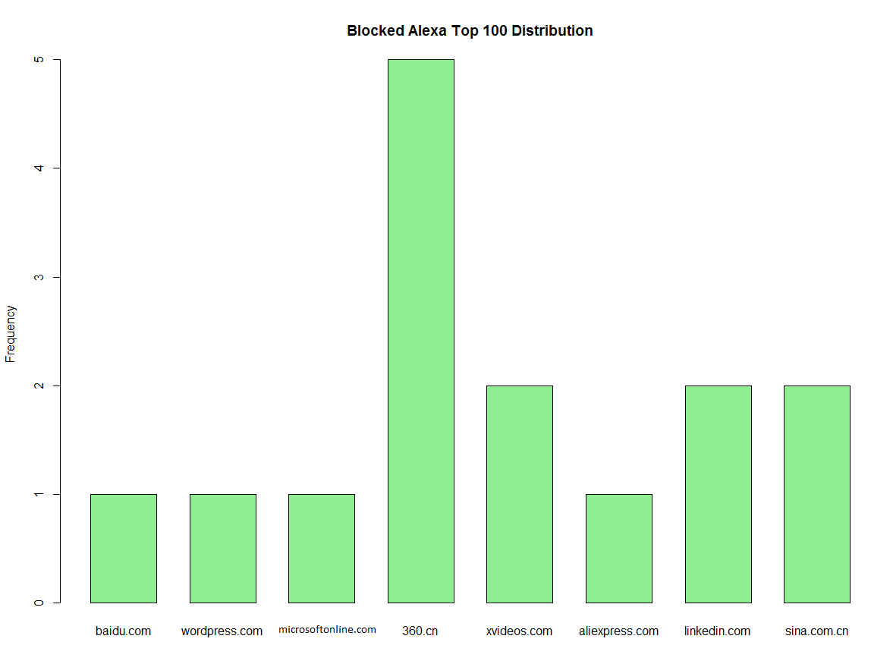
Evaluating the Prediction Power

Slide 82
Future work
Shrinking the blocking space while retaining the predictive power
  Differentiate different types of shared host environments
  Examining other metrics such as TTL, Port Number, Protocol, WHOIS
Creating a predictive model

Slide 83
Overview Background Slides movenet: A Cyber Agility Framework for Resilient sdn*
*The original architecture appeared IEEE INFOCOM 2015

Slide 84
Multi-layer Auto-Resiliency Decision-Making-- Strategies vs Tactics
TTPS
Randomization
Mutation
Deterrence
S-Diversity
Proactive
Proactive
Recovery
Strategy
Auto-
Isolation
CYBER
Post-Attack
Resiliency
Multi-layer
Resiliency
Kill-Chain
Resistance
generation
Tactics
Evolving
Reactive
Resiliency
D-Segmentation
/ Static
Techniques
(examples)
Reconstruction
Dynamic
Adaptive Response
Reposition
ATTACK

Slide 85
Motivation
In the current network protocol infrastructure, network configuration parameters such as IP addresses are mostly static.
Dynamic configuration such as changing IP by DHCP and NAT are still too slow and inefficient to provide proactive countermeasures.
In cyber war, this gives a significant advantage for adversaries to remotely scan networks and identify their targets accurately and quickly
Moving Target Defense was proposed as a new game changing paradigm to re-establish the cyber game rules for the advantage of defenders.

Slide 86
Introduction
Static and predictable behavior of cyber system a fundamental design vulnerability
  Reconnaissance is simple
  Evasion is simple: careful selection of attack parameters allow evasion
    A worm scanning network with rate 1 scan/min can evade all major detection techniques
IP address allocation is mostly static
Many various scanning strategies:
  Random, local, cooperative, hybrid, etc
Notes:
The static and predictable behavior of cyber systems creates a fundamental design vulnerability
allows adversaries to not only plan and launch attacks effectively, but also learn
and evade detection easily.
This staticness simplifies reconnaissance and information gathering, because the collected information hardly gets obsolete.
it has been shown that a worm scanning a network with a rate of one scan per minute can evade all major detection techniques, including TRW.

Slide 87
Cyber Agility for Proactive Resiliency

Slide 88
What is Cyber Agility?
Cyber Agility
Agility is the system property that allows the system to proactively defend against unknown threats by dynamically changing the system parameters/states in timely fashion in order to resist and mitigate attack occurrence and consequences without degrading the QoS.

Slide 89
Regeneration Based on Attacker’s
Perception and Interpretation
Shadow
Regeneration
True
Regeneration
Resilience
depth
Perceived
Environment
Real World
Action
Attack
Fails
Attack
Succeeds
Response
Scan
Planning
Attacker’s
Interpretation
(of Environment
Parameters)
Attacker’s
Perception
(of Environment
Parameters)
Revise/Adapt

Slide 90


Cyber Agility is To Slow or Interrupt Attack Cycle
Reconnaissance
Fingerprinting
Planning/
Coordinate
Intrusion/
Attack
Propagate

Slide 91
Objective
Mutation: assign/change hosts virtual IPs (VIP) randomly and synchronously over time while preserving the system requirements.
  Random mutation to increase the uncertainty on the adversary
  Frequent mutation to outperform powerful automated scanners
Safety: Correct mutation to preserve network configuration integrity
Non-intrusiveness: Seamless mutation to minimize service disruption and traffic delays
Transparency: Transparent architecture to deploy RHM on existing networks with no significant changes in the end-hosts or network infrastructure.

Slide 92
Objectives & Contributions
Developing an adaptive moving target defense that can defense against unknown strategies of scanning attacks cost-effectively, while satisfying the following properties:
Transparency: no significant changes in the end-hosts or network infrastructure.
Unpredictability: highest possible unpredictability and mutation rate.
Integrity: safe mutation that preserves network operation and active session integrity
Fast adaptation to adversary strategies: adapting address mutation to adversarial scanning strategies.
Notes:
we propose a novel technique that establishes proactive adaptability into the network in order to defend Enterprises from known and unknown (zero-day) external and internal reconnaissance and scanning.
Our approach randomizes (i.e., changes) the IP addresses of network hosts frequently, in order to make them untraceable for network reconnaissance attacks.
The distribution based on which these eIPs are assigned to network hosts, considers potential attacker’s actions and adapts accordingly.
Characterization of adversarial behavior and adaptation must be fast and accurate to maximize disruption against attack.

Slide 93
MTD Benefits:
3D MTD Goals – for Proactive Defense
Deterrence Metric measures the MTD capability to increase the attack cost. Dimensions: time, effort, knowledge, resources, profit, image etc
  E.g., RRM forces attackers to have more bot sources
Disruption Metric measures the MTD capability to increase the risk of detectability/traceability by forcing the attacker to altering her behavior.
  E.g., RHM increases detectability by forcing scanners to either increasing their scanning rate or sending frequent DNS queries.
Deception Metric measures the MTD capability (probability) to divert the attack from reaching the goal eventually.
  E.g., fingerpritniunbg deceive attackers.

Slide 94
RHM: Random Host IP Mutation for Moving Target Defense

Slide 95
MTD Mechanisms by UNC Charlotte
Random Host Mutation
Random Rout Mutation
Footprint Mutation – MoveNet
URL mutation
AP mutation
Fingerprinting Mutation
Honeypot Mutation

Slide 96
DDoS Evolution
First Generation: Volumetric DDoS → Direct, High rate, Large volume
  If reaches at the network gates → Game Over
Second Generation (evasive DDoS): Direct, Low rate, Large scale
  Targets only network level critical links, e.g., Crossfire Attack
Third Generation (stealthy DDoS): Indirect Slow & Low rate, Large Scale
  Corssfire [S&P13, CS14], crosstalk, .. etc
Courtesy: http://www.neustar.biz/resources/whitepapers/2014-neustar-ddos-report

Slide 97


DDOS Attack: Aggressive + Stealthy
Selected as Decoy Servers
Active
Selected as Active Bots
Shared link
Bots
Data paths remain static
Geographical Neighbors
Decoy Servers
Only few links carry most of the traffic (Critical)
Perform Network Reconnaissance through Traceroutes
Benign Users
Critical
Data Path
Destination
Inactive Bots
Bots becomes inactive
Remain just neighbors
Geographical Neighbors

Slide 98
What is MoveNet?
MoveNet migrates victim traffic away from the critical link
Proactively Identify Critical
Before reconnaissance is completed
Create a Virtual Network
Bots
Move Primitive:
Split Primitive:
Merge Primitive:
Benign Users
Critical
Destination
Geographical Neighbors

Slide 99
Virtual Network (VN)
Z
X
Y
P
Q
Virtual Network
R
Substrate
A
B
C
D
E
F

Slide 100
MoveNet: Objectives and Capabilities
MoveNet is a decision-making engine/framework for synthesizing, planning, and coordinating a correct-by-construction active cyber defense strategies on Software Defined Networks.
MovNet ACD Capabilities and Tasks
  Provable ACD: It automatically creates course-of-actions to deter and/or mitigate stealthy DDoS, MiM, and recon infrastructure attacks with provable security and performance guarantees.
  Automated: MoveNet can automatically migrate, swap, split, or merge multiple virtual networks (VNs) randomly to frequently change the critical network physical footprint and deceive and mitigate attacks in timely manner.
  Extensible Framework: It provides cyber agility primitives (monitor, detect, migrate, swap, split, merge, redirect, erc) to can be used for developing novel active cyber defense in SDN (on going task).
  Automated Orchestration: and coordination of ACD using SDN (on going task).
  MoveNet provides proactive, reactive and hybrid defense (on going task).

Slide 101
MoveNet Correct-by-Construction Planning Approach
Migrating VNs to frequently mutate the critical physical cyber footprint randomly, while satisfying the following constraints:
  Timely Mutation: The mutation time to new footprint must be fast to invalidate the attacker’s knowledge (migration time < reconn time), and isolate attack traffic quickly.
  Unpredictable Migration: Attackers must not predict the new critical footprint.
  QoS-aware Mutation: VN mutation must satisfy the QoS and continuity for all active flows.
  Cost-effective network-aware migration: VN must consider
  Adaptive ACD: migration/mutation strategy is tunable to adapt to various attack models that consider knowledge, resources, and speed.

Slide 102
MoveNet Proactive Resiliency Approach
Proactively migrates the critical footprint of VN to replace with threat-safe network resources to invalidate network reconnaissance for DDoS
MovNet Constitutes 4 components as follows:
Used Satisfiability Modulo Theory (SMT) to develop MoveNet
  Implements migration strategy onto a virtualized physical network by handling sequence/scheduling of migration steps
  Formal model of VN placement to ensure provably correct resource allocation under continuous migration
  Formally define migration time and unpredictability constraints to ensure safe migration
  Stealthy DDoS threat modeling to know what could be attacked and when it could happen
VN Placement
How to Migrate
Migration Mechanism
PlanetLab
&
Mininet
What to Migrate & When to Migrate
Migration Strategy
How to Implement
Threat Model
MoveNet
Strategy
Threat-aware Migration
Where to Migrate

Slide 103
Comprehensive Multi DDoS Resiliency Mechanism
Different DDoS attacks require different defense mechanisms
Developed VN agility based primitives such that these can be combined in different combinations to comprehensively defend DDoS attack
Four primitives are:
  Move Primitive
  Split Primitive
  Swap Primitive
  Merge Primitive

Slide 104

Adaptive Defense Strategy
Defense Strategy: Combining these agility primitives in different combinations to devise a defense approach against different DDoS attacks
Proactive
Reactive
Revised (Fine grain)
New
DDoS Type | Defense Mode | Move | Split |  |  | Swap | Merge
 |  |  | DS | FS | CS
Slow Low Rate Indirect DDoS Attack | Proactive
Aggressive Direct DDoS Attack | Reactive
Slow High Rate Direct DDoS Attack | Proactive
Aggressive Indirect Direct DDoS Attack | Reactive

Slide 105
Composing Agility based Defense
Attack detected
$¬$ mitigated ➔ increased sensitivity
No attack with decay function
Proactive
Reactive
Update Proactive Strategy
Mitigated
Decay Function
Reduce the frequency of migration,
Reduce the number of destinations to be migrated, Etc.
Update Strategy
Adjust the reconnaissance time based trigger
Adjust flow level detection threshold
Adjust migration frequency
Adjust unpredictability parameter, etc.

